Slide 1

Midterm 2 Assignment 3
Intelligent Systems for Pattern Recognition
Master Degree in Computer Science, AI Curriculum
A.Y. 2020/2021
Alessandro Ristori

Slide 2
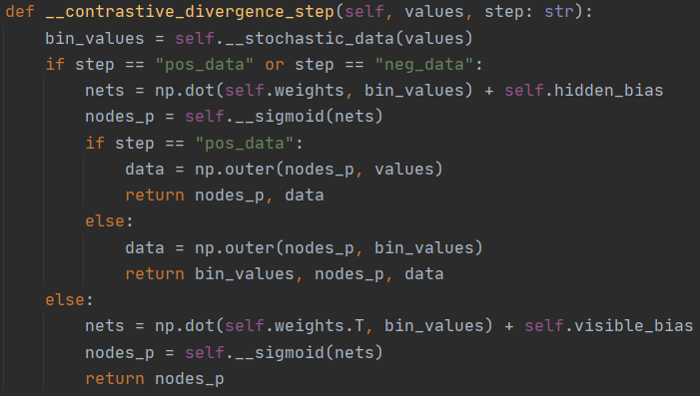
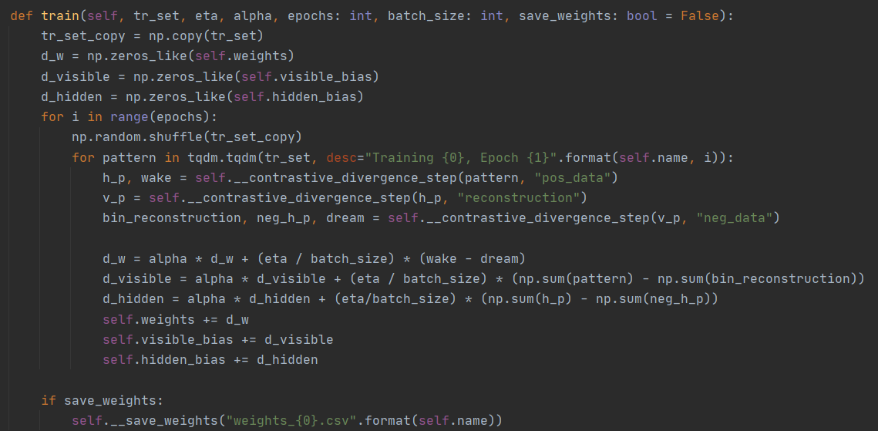
RBM Code

Slide 3
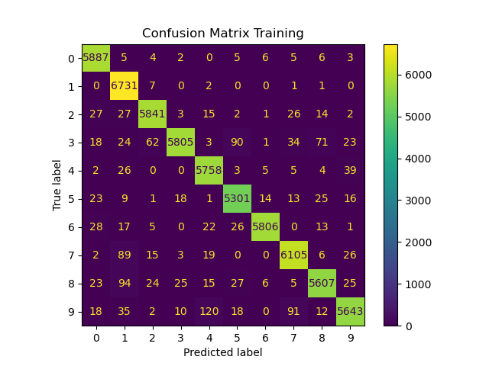
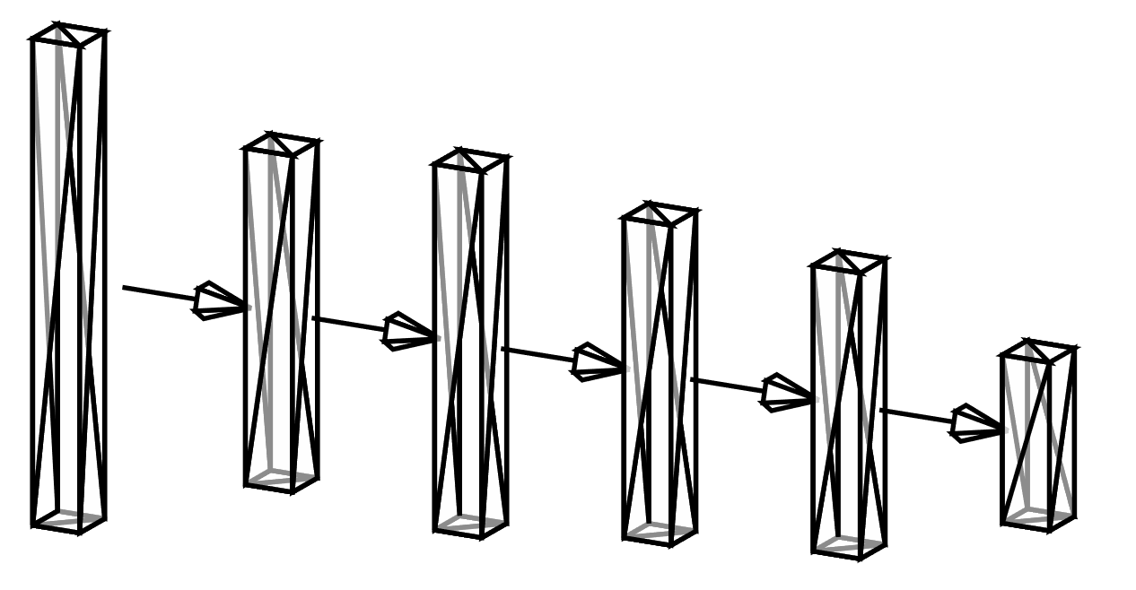
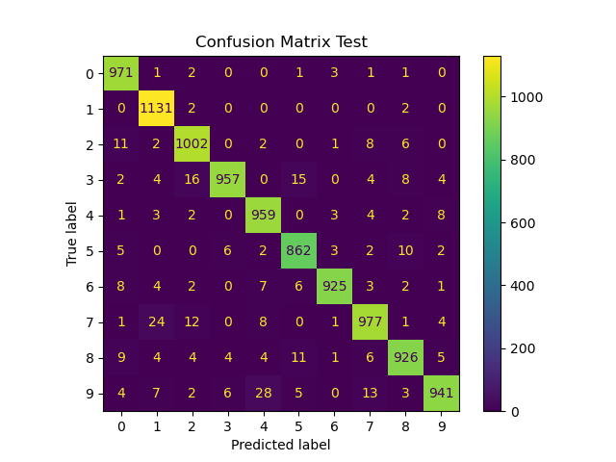

Model and confusion matrices
Visible layer 784
HIdden layer 100
ReLu 150
ReLu 80
ReLu 50
Softmax 10
RBM
Classifier

Slide 4



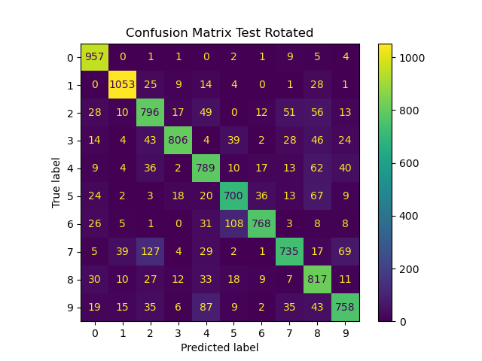


What if we rotate the digits by a few radiants?
It seemed that the model was somewhat sensitive to the rotations (as expected), even the most insignificant ones; so i tried testing it in real time using opencv.
-π/6 rotation
Original digit
$π/$6 rotation

Slide 5
Final considerations
Stacking RBMs, before passing the encodings to the classifier, didn’t have the desired effect, in some cases it made the accuracy worse;
CD-k was abandoned since it was too time expensive and it didn’t produce any visible improvement on the final accuracy;
The random rotation were limited in the range [- π/4, π/4], any more rotations would have made the test useless;
The real time recognition works only if the digits are written with a decent-size font, otherwise the network would receive a very noised pattern.
Even though i obtained nice results with a simple network, the same results can be achieved with fewer and smaller layers in the classifier.
Thank you for your attention

